Slide 1
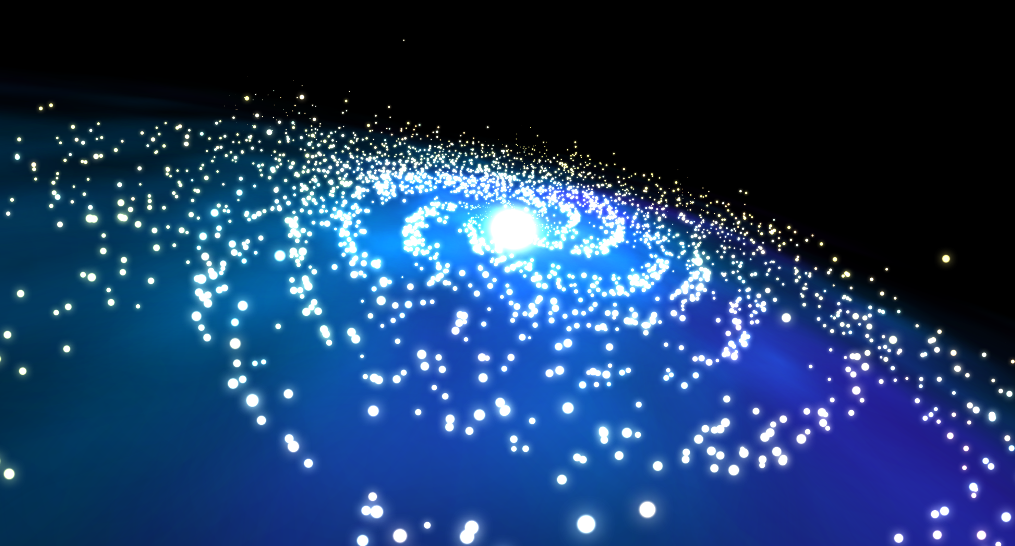
CSE 490V VIRTUAL REALITY SYSTEMS
Galaxy Tour
Wenqing Lan and Natalia Abrosimova

Slide 2
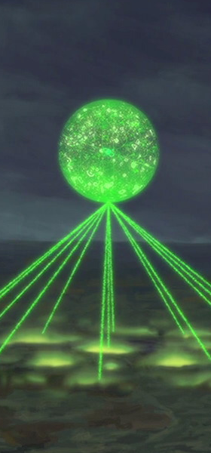
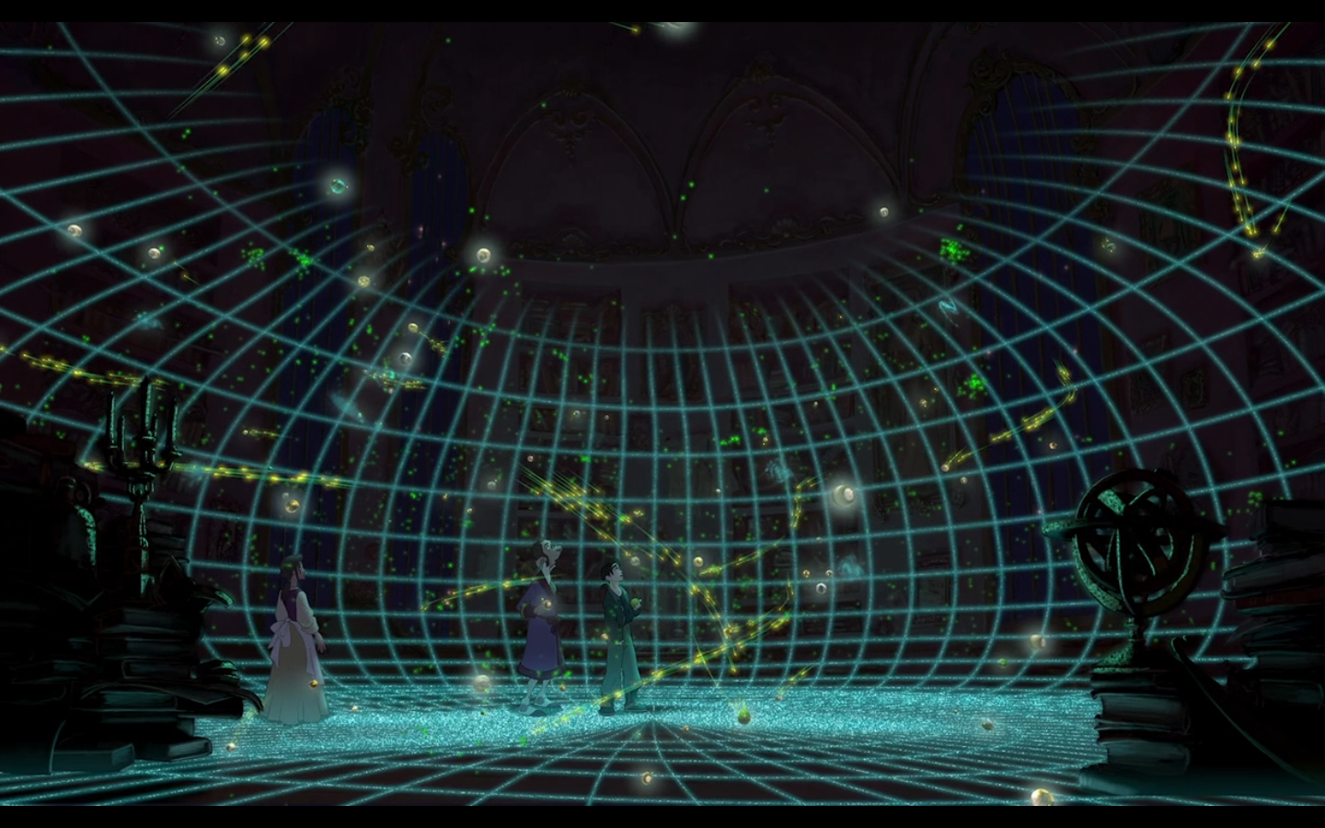
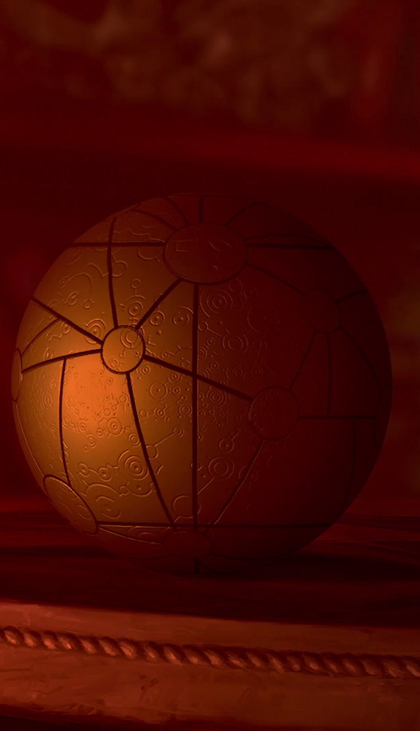
MOTIVATION
We all had to go through learning the motion of planets and and moon, and how our
solar system works and that solar system is only one small particle in the galaxy. We
waned to create an environment where students can see the motion of planets and stars in 3d to allow them to have better understanding of space. Our original idea was inspired by childhood fantasy to have the map from the Treasure Planet.

Slide 3
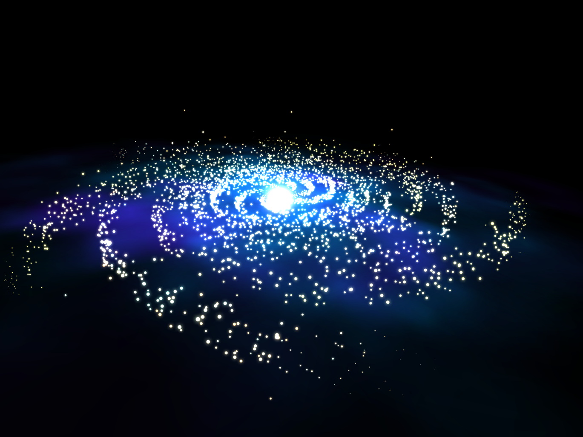
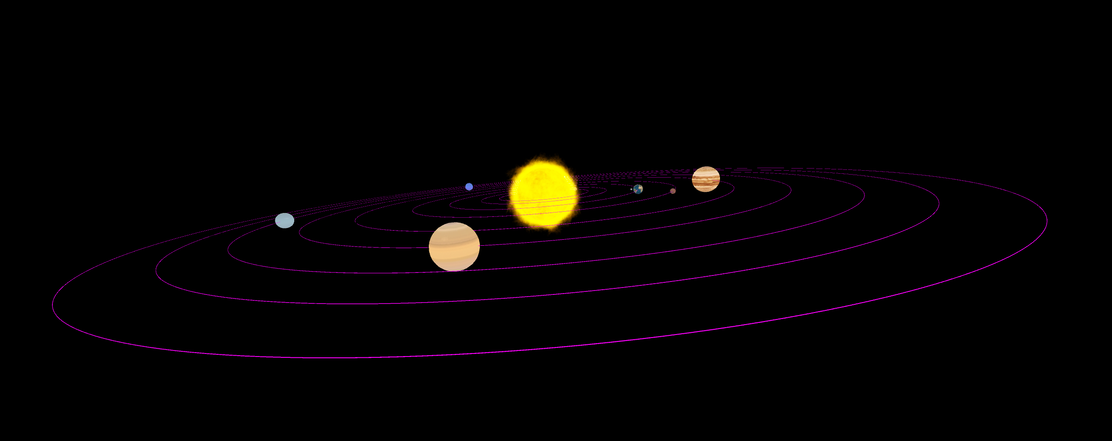
OVERVIEW
We focused on planet motion and
visual realistic effect.
Users who participated enjoyed the idea and found it relaxing
watching the movement of stars and planets.

Slide 4
RELATED WORK

Slide 5
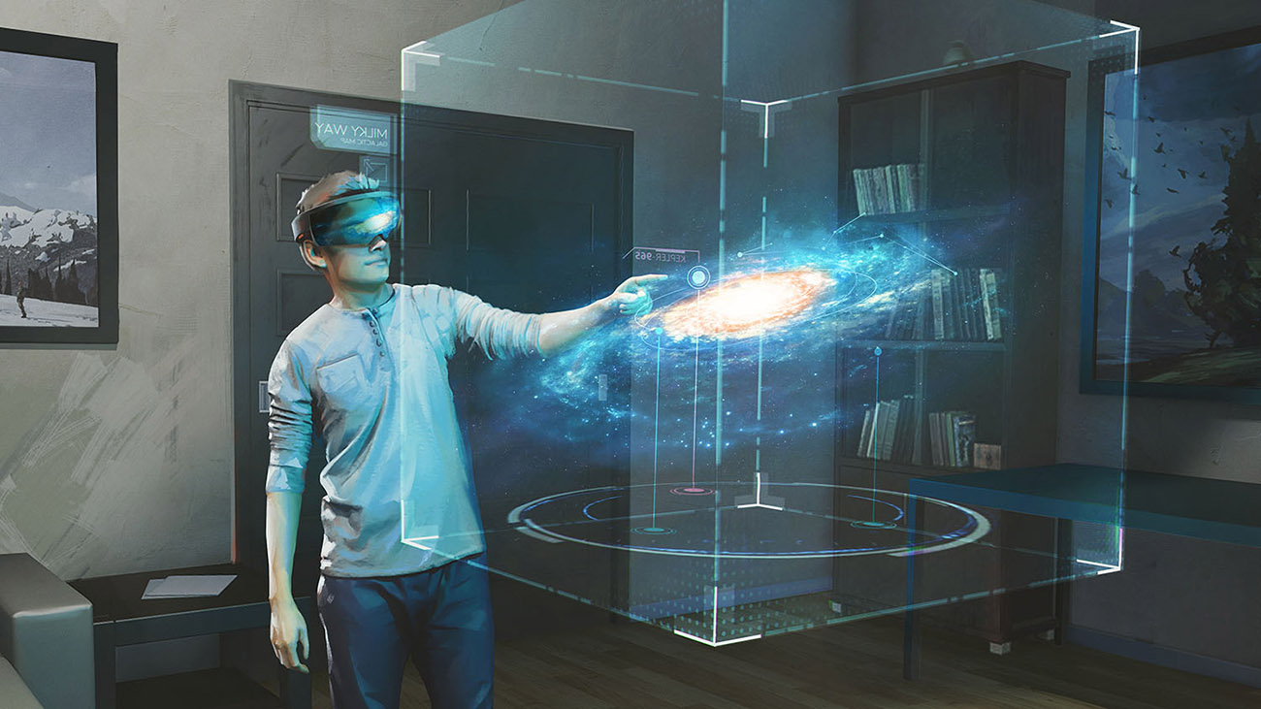
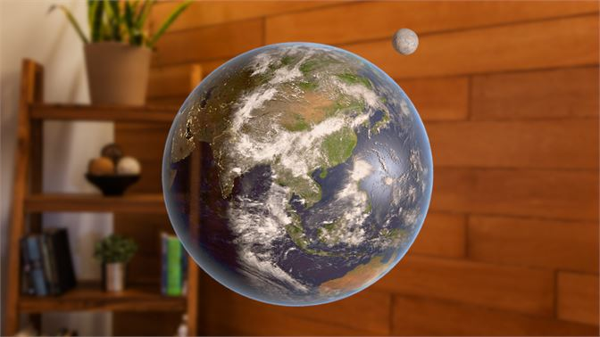
TOPIC 1
For implementation our inspiration was Galaxy Explorer by Microsoft

Slide 6
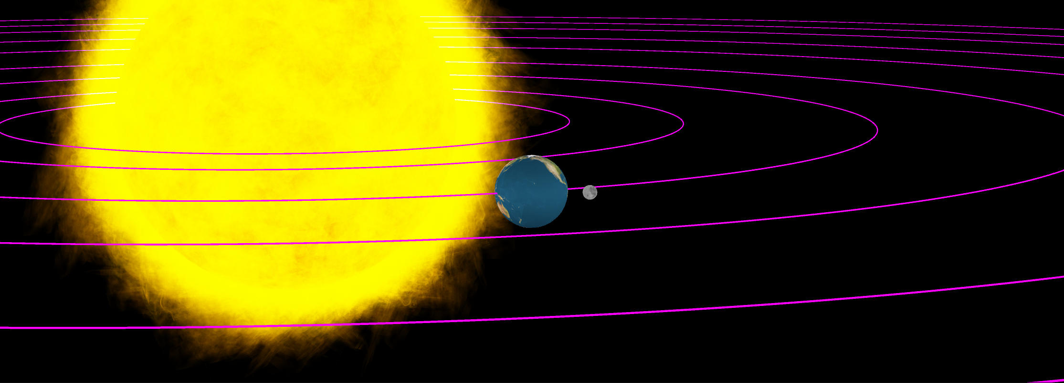
TOPIC 2
Unlike previous implemented project we wanted the experience to be in VR. Lack of outside environment allows user to fully concentrate on object in front of them.
Our visualization is less detailed since we tried to create our own textures or textures we can get for free at asset store.

Slide 7
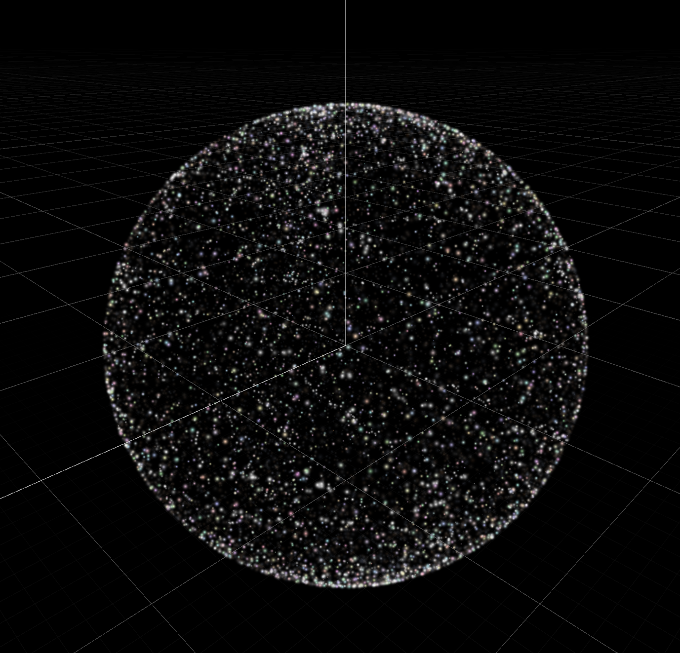
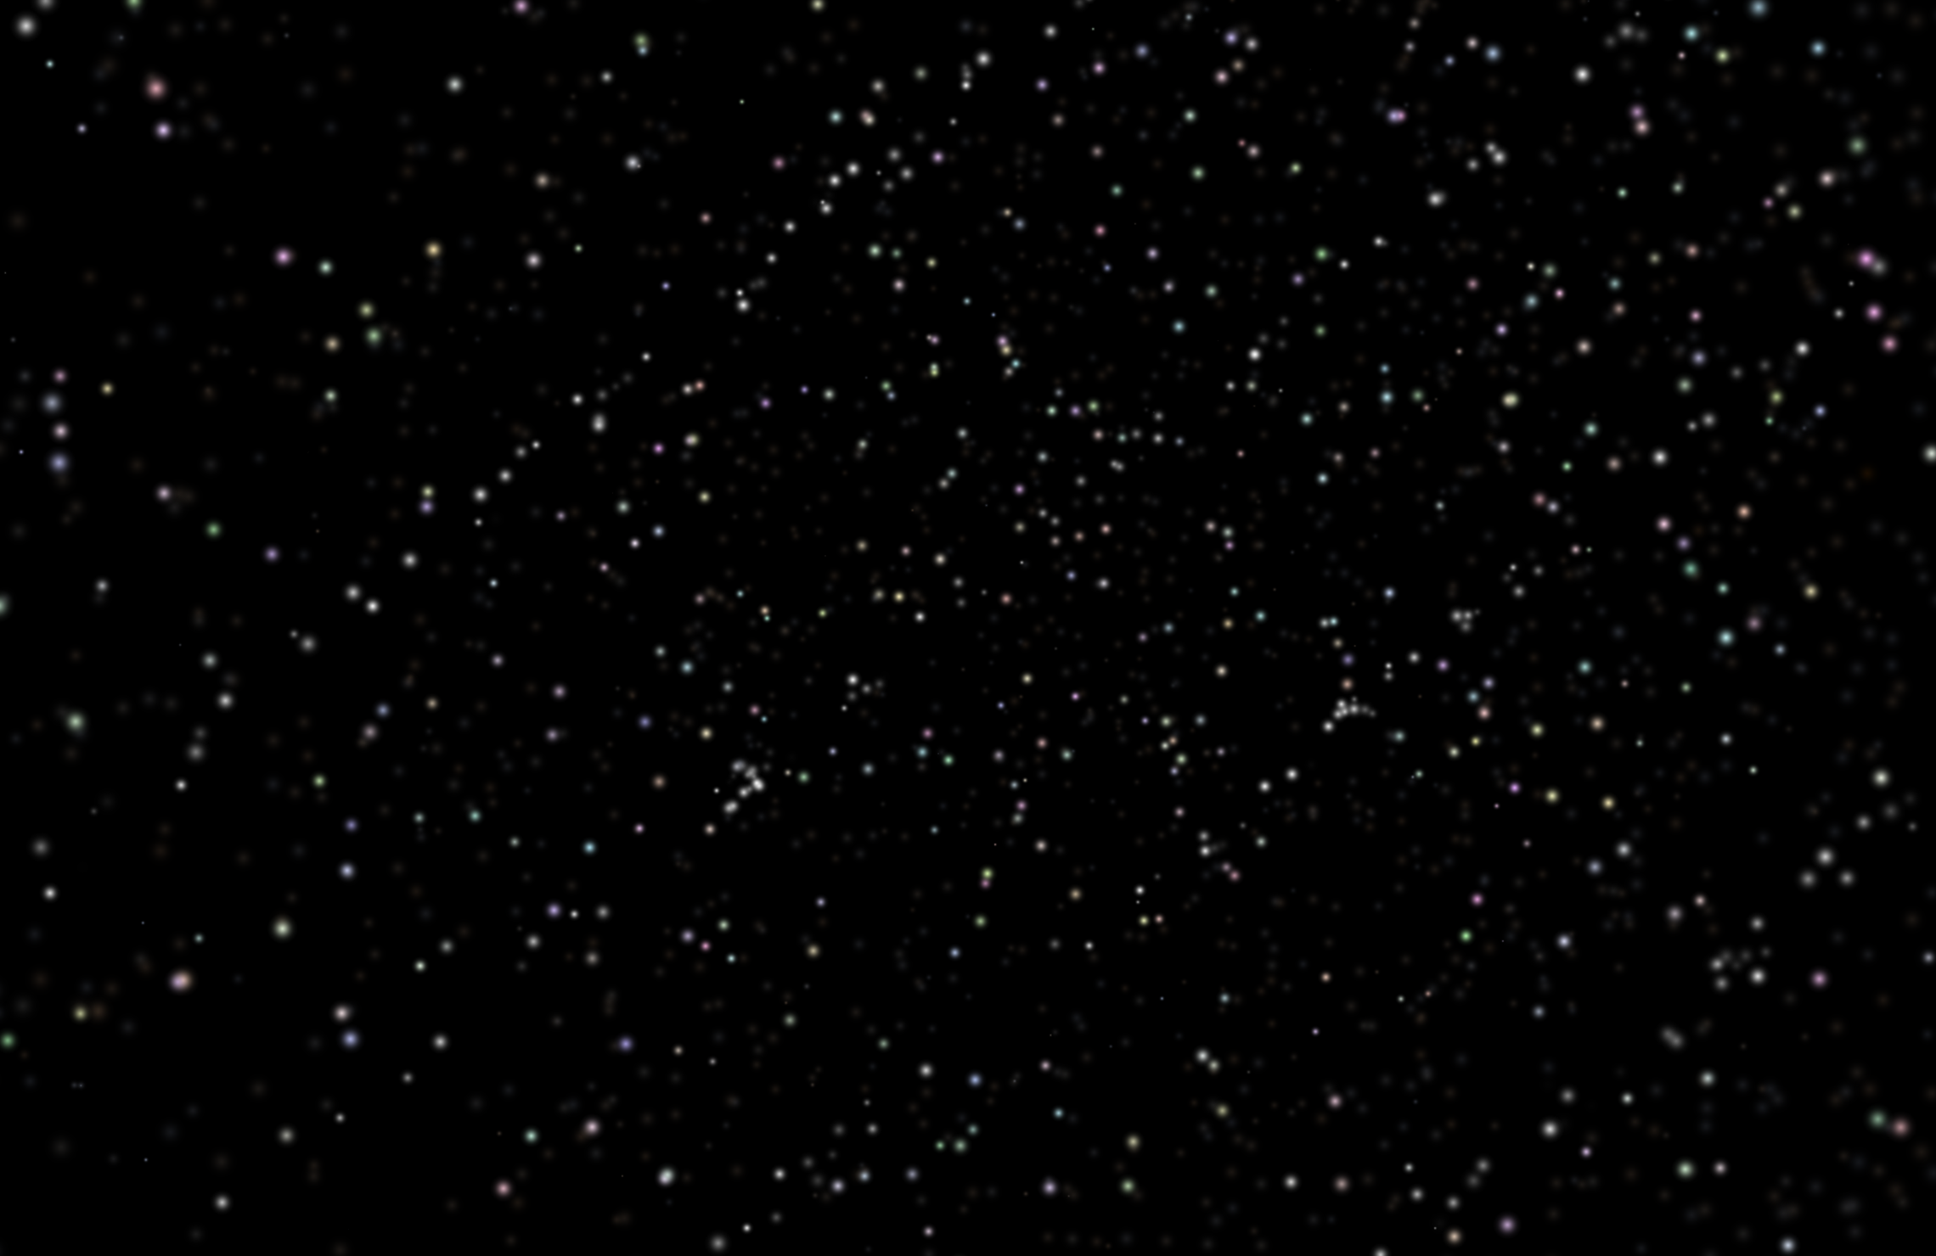
TOPIC 3
We also added scene that showed night sky. to make a logical transition from seeing starts, seeing solar system and then galaxy.

Slide 8
IMPLEMENTATION DETAILS

Slide 9
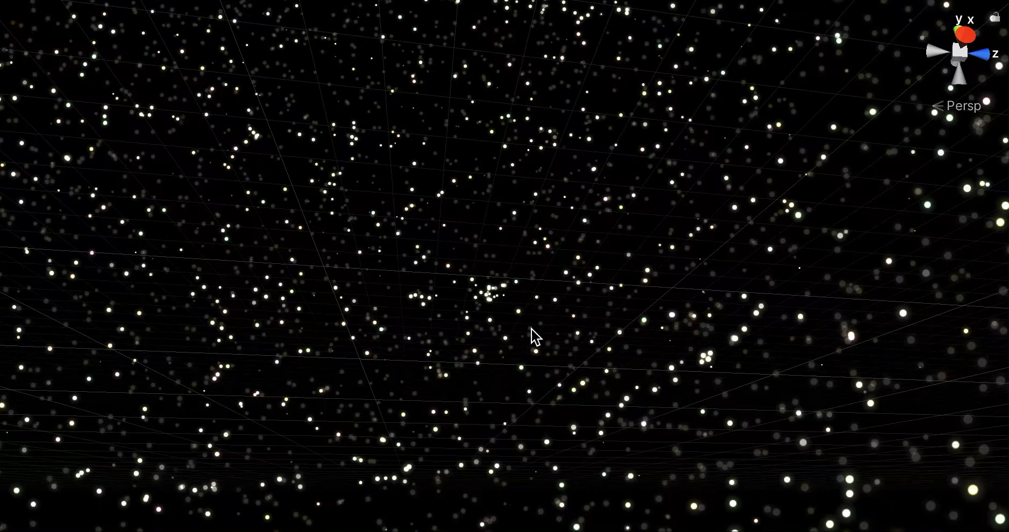
SOFTWARE DISCUSSION

Slide 10
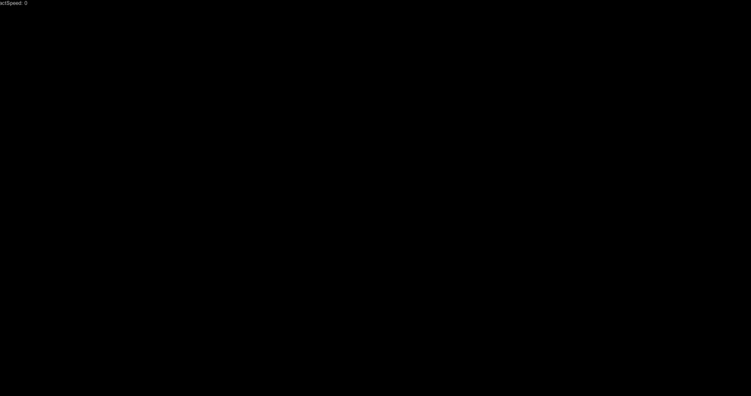
SOFTWARE DISCUSSION

Slide 11
SOFTWARE DISCUSSION
For stars we used the hyg dataset, that we parsed. We used index and
magnitude to estimate the size and color of stars.
For planets the hardest part was figuring out how to draw orbits.
For galaxy, we had to draw clouds so we photoshopped a texture to
create cloud/fog like image.
To make the transition between scenes feel smoother we added
animation of fade-in effect.
Player can transition using x button on controller.

Slide 12
EVALUATION OF RESULTS

Slide 13
BENEFITS AND LIMITATIONS
We wanted to make visual representation of space that will be interesting to younger generation and inspire their learning.
A 2D representation lack clarity when it comes to 3D models, they cannot show the speed of stars nor how they would look if you could see all the stars around you as if earth was see-through.
Our application has limited functionality due to limited time and lack of prior knowledge; we could have added some descriptions or explanations as future works.

Slide 14
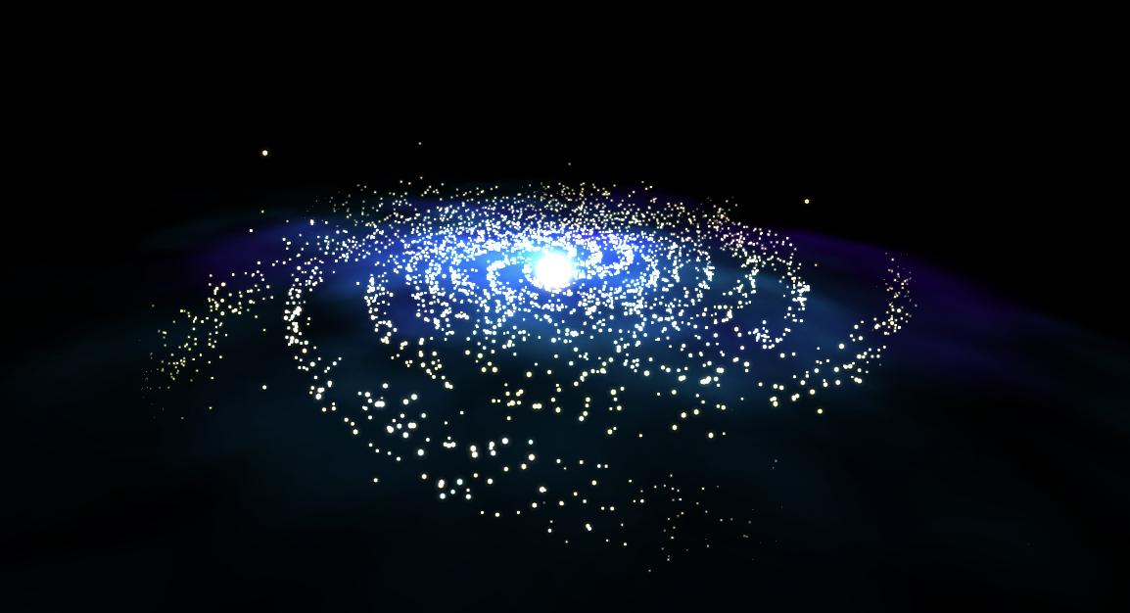
USER FEEDBACKS
User 1: Early stage of development. Too many particles drifting away, making the galaxy seem to fall apart.
User 2: Rotational speed of planets is too high, distracting to look at. After we added real rotational speed and found the number actually works out well, the Solar System looks more satisfying to the user.

Slide 15
CONCLUSION

Slide 16
SUMMARY OF CONTRIBUTIONS
Our goal for this project was to learn unity and explore working with Oculus Quest. We wanted create a simple MVP of project that would inspire students to learn about
space.
a project itself.
rendering of visualizations of stars, planets and etc using particle systems and spheres
processing of data from star database.

Slide 17
FUTURE WORK
Overall, our application is expendable, it can teach about types of stars, student could watch creation of galaxy, or evolution of planet.
Add different types of galaxies.
To compare how they look and function in one space.
Add more elements to solar system, like asteroids belt. Update orbits into ellipses.
Improve galaxy shadows

